Slide 1
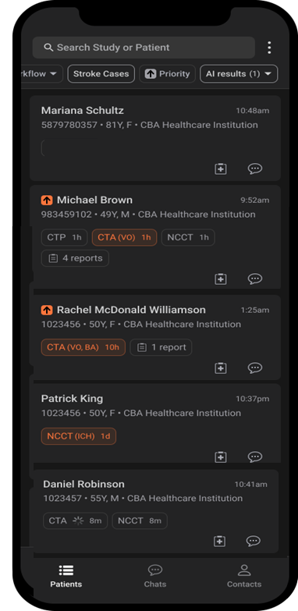
Marina Schultz
Card created when patient scan is identified as taken under stroke protocol – before imaging uploaded. AI analysis not performed yet.
Michael Brown
Card created when patient scan is identified as CTA taken under stroke protocol. Flagged by AI for suspected VO.
Rachel McDonald Williamson
Card created when head CTA analyzed for VO under non-stroke protocol. Flagged by AI for suspected VO & suspected BA
Patrick King
Card created when imaging verified as NCCT taken under non-stroke protocol (trauma). Flagged by AI for suspected ICH.
Daniel Robinson
Card created when imaging verified as CTA taken under non-stroke protocol (trauma). AI analysis did not produce any flags.

Slide 2
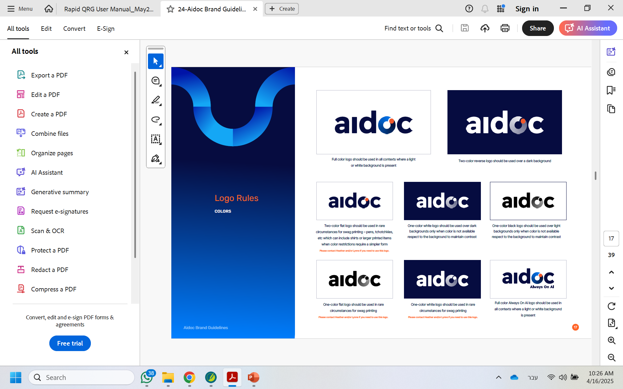
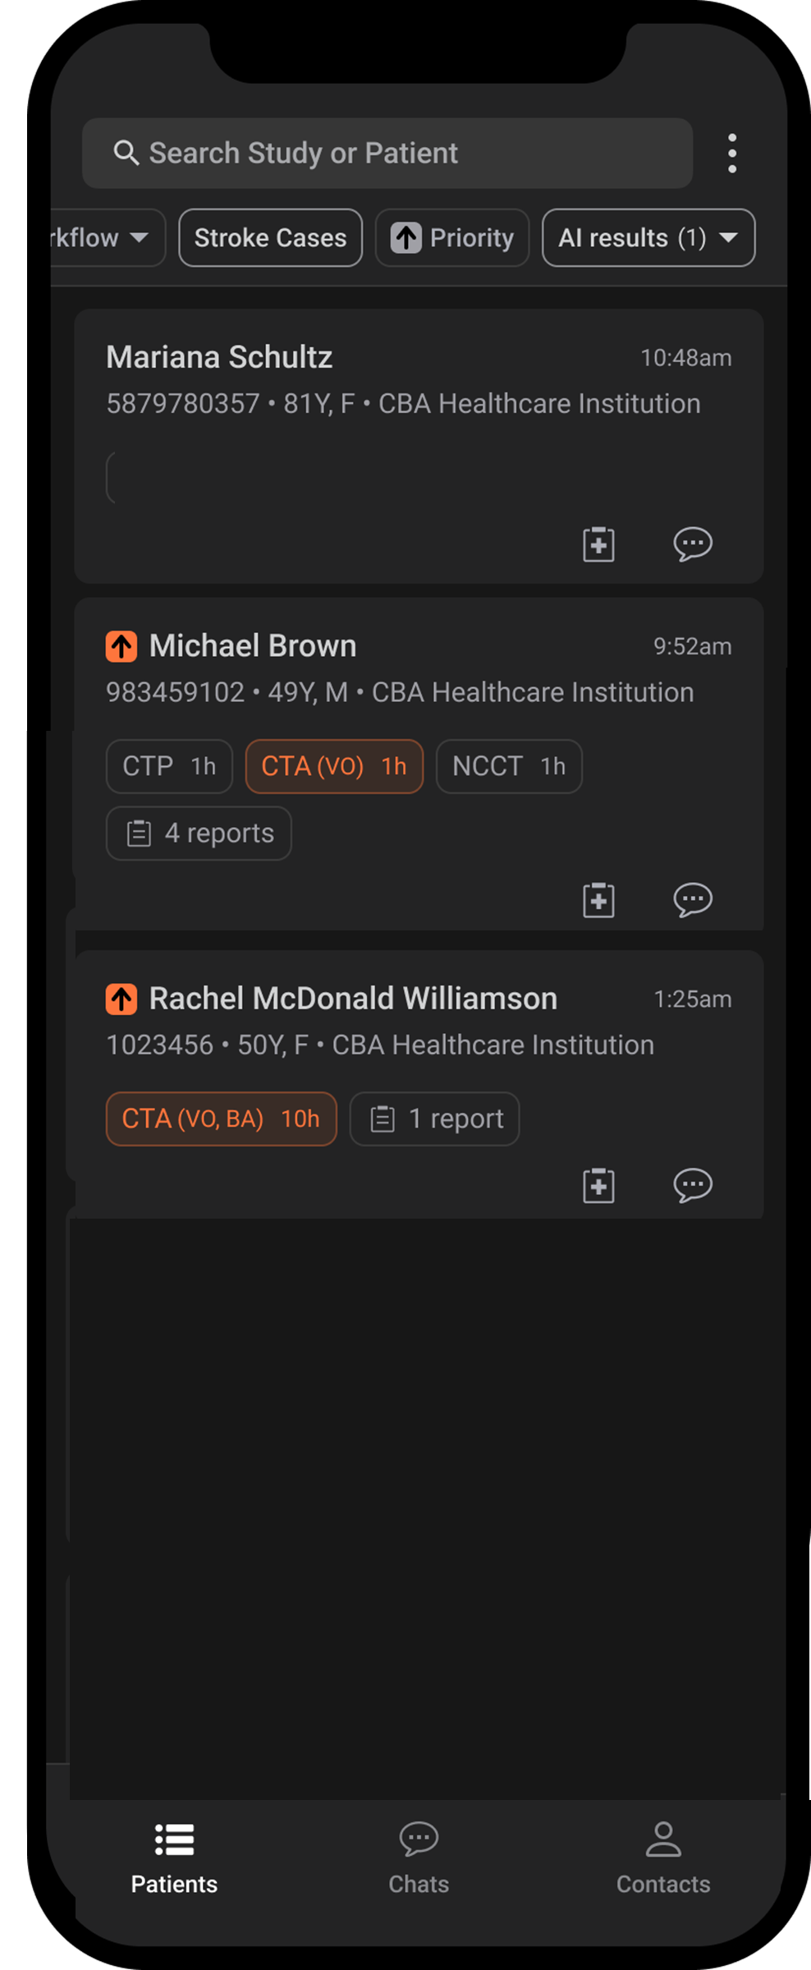
[Approved] UG0002 Rev 1.0 2025-05
Stroke Mobile Solution Enhancements Package
©Aidoc 2025
User Guide: Stroke Cases Filter
Patient Cards with imaging conducted under stroke protocol (dedicated stroke imaging), regardless of AI analysis results.
Patient Cards with imaging not conducted under stroke protocol (non dedicated imaging) flagged by AI for suspected VO
Default Stroke Feed
Filtered In
Default Stroke Cases Filter
Marina Schultz
In Stroke Filter – dedicated stroke imaging
Michael Brown
In Stroke filter – dedicated stroke imaging
Rachel McDonald Williamson
In Stroke Filter – suspected VO flag
Filtered Out
Patrick King
Not in Stroke Filter
Daniel Robinson
Not in Stroke Filter

Slide 3
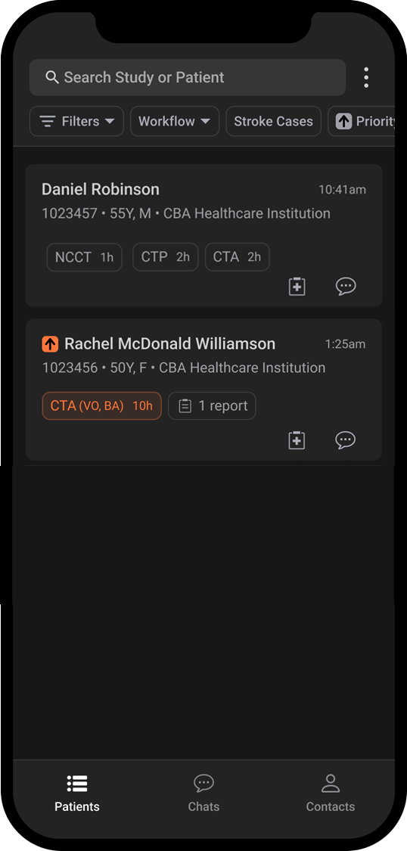
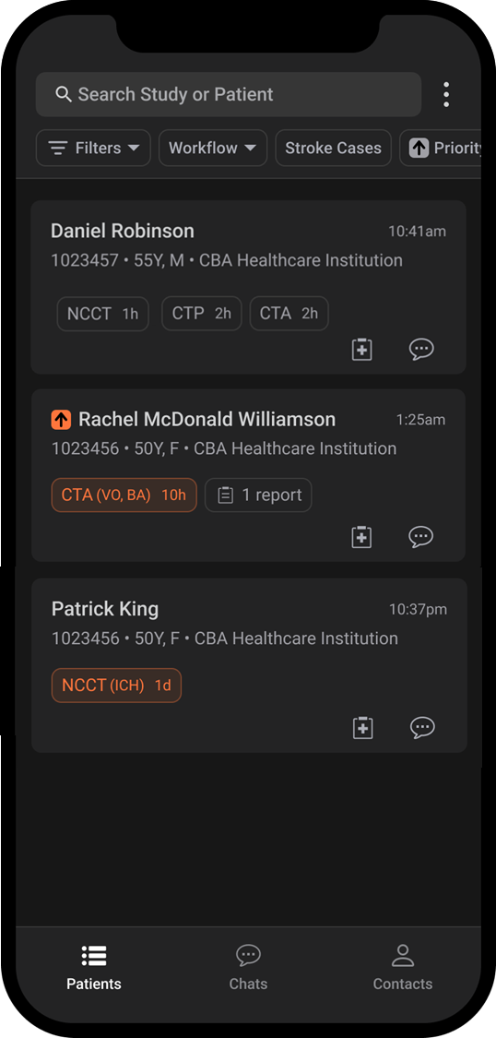
[Approved] UG0002 Rev 1.0 2025-05
Stroke Mobile Solution Enhancements Package
©Aidoc 2025
Stroke Cases Filter: Standard Configuration
Stroke Cases Filter: Standard + ICH Configuration
Daniel Robinson
Card created when imaging verified as CTA taken under stroke protocol
In both filter configurations: stroke-related imaging
Rachel McDonald Williamson
Card created when head analyzed for VO
Flagged by AI for suspected VO
In both filter configurations: suspected VO flag
Patrick King
Card created when imaging verified as NCCT taken under non-stroke protocol (trauma).
Flagged by AI for suspected ICH
In Stroke filter with Standard + ICH configuration due to ICH AI flag
6

Slide 4
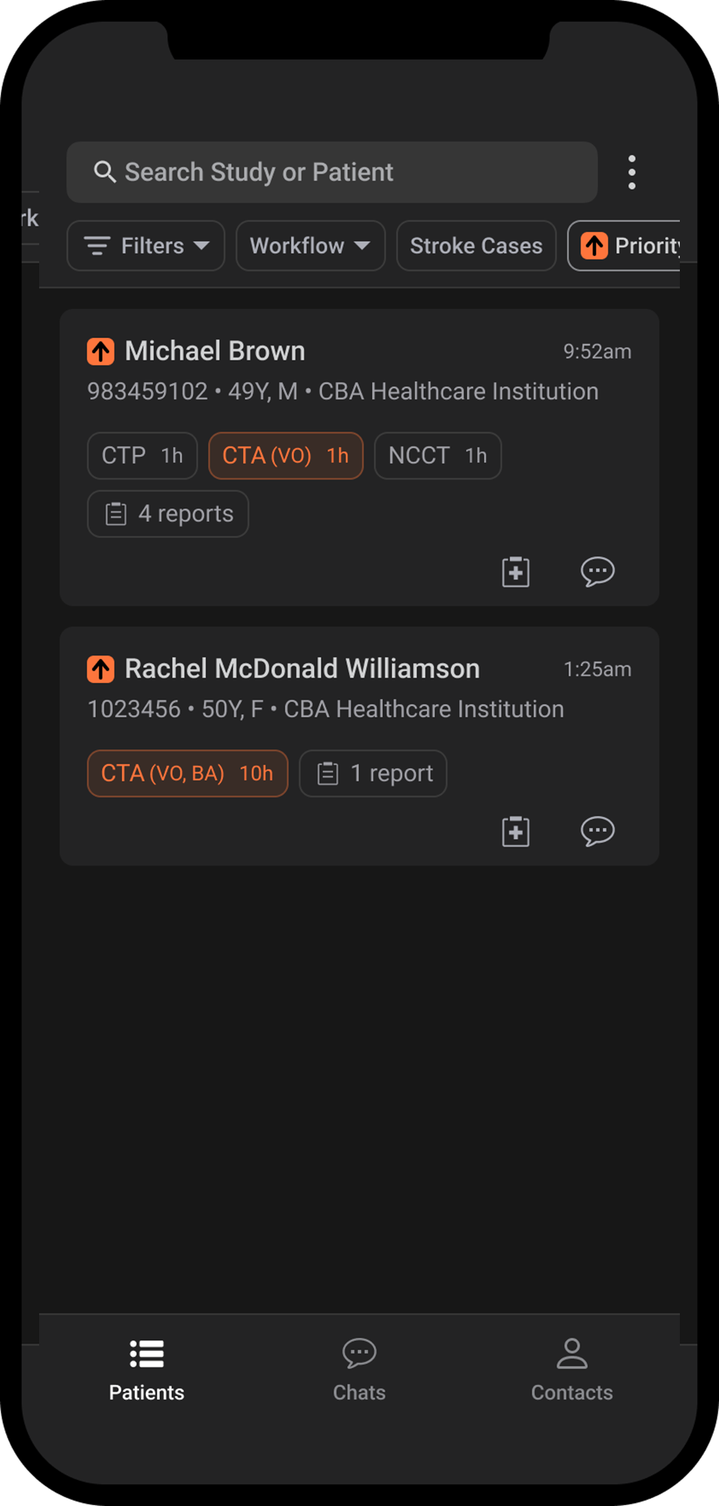
[Approved] UG0002 Rev 1.0 2025-05
Stroke Mobile Solution Enhancements Package
©Aidoc 2025
Default Stroke Feed
Stroke Cases + Priority Cases Filters
Michael Brown
Dedicated Stroke Imaging
AI flag for suspected VO
Priority icon due to suspected VO
Rachel McDonald Williamson
Non-dedicated Imaging
AI flags for suspected VO and suspected BA
Priority case due to suspected VO

Slide 5
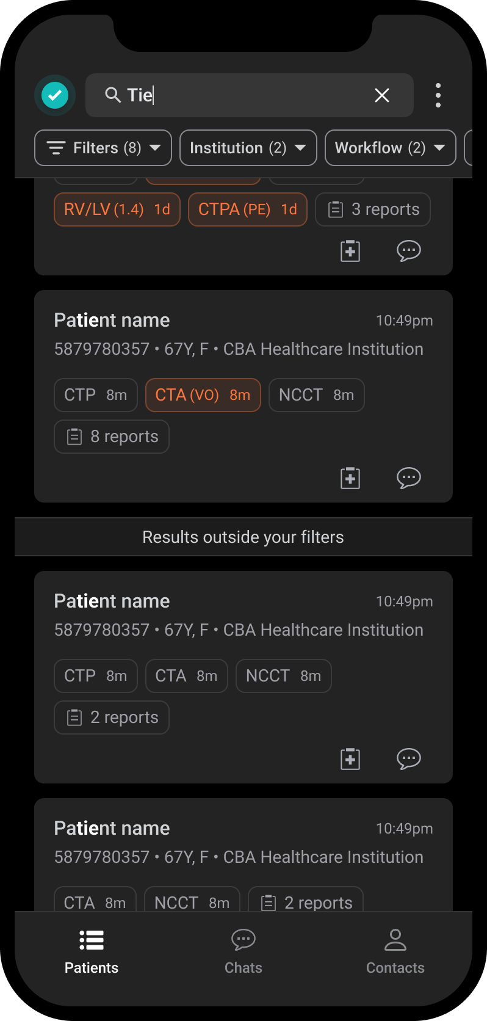
[Approved] UG0002 Rev 1.0 2025-05
Stroke Mobile Solution Enhancements Package
©Aidoc 2025
User Guide: Stroke-Focused Mobile Feed
Searching with Filters
Running a search while filter/s are applied may exclude Patient Cards that do not correspond to filtering criteria. Search results excluded due to filtering will appear under the indicator “Results outside your Filter”
8

Slide 6
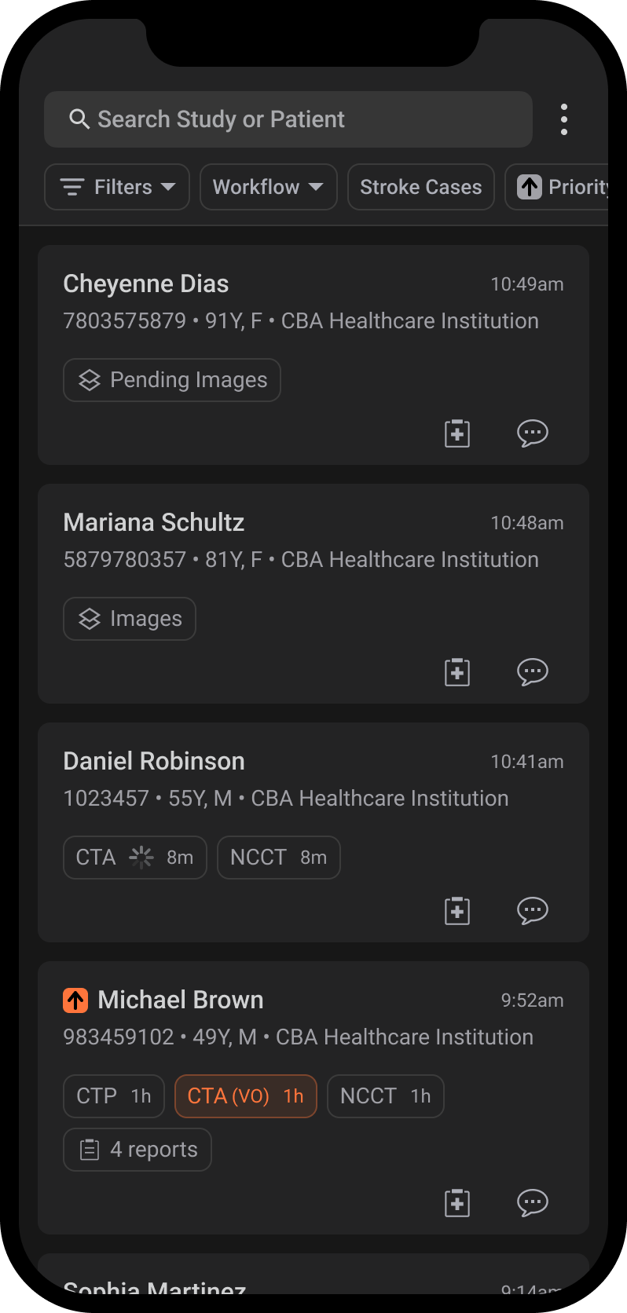
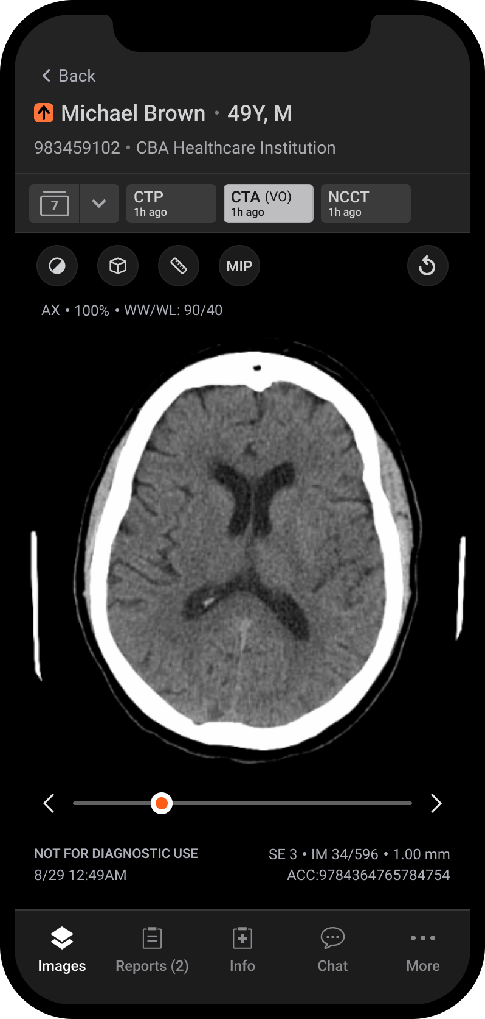
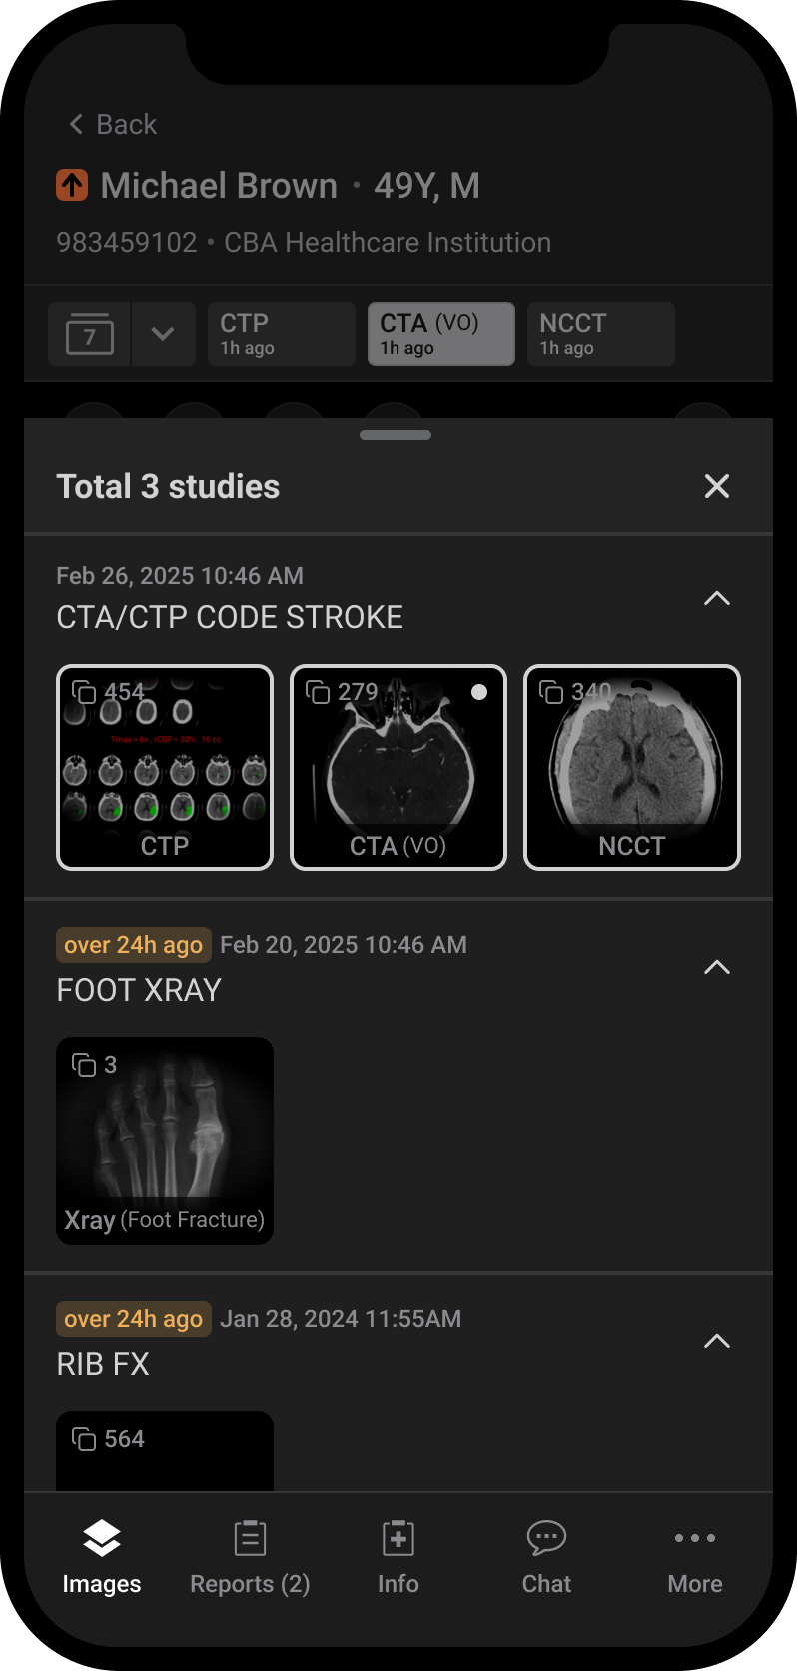
[Approved] UG0002 Rev 1.0 2025-05
Stroke Mobile Solution Enhancements Package
©Aidoc 2025
User Guide: Enhanced Imaging Library

Slide 7

[Approved] UG0002 Rev 1.0 2025-05
Stroke Mobile Solution Enhancements Package
©Aidoc 2025
User Guide: Enhanced Imaging Library
Image Viewer Layout
Library icon indicating the number of imaging studies available in the Library.
As imaging studies are added to the Library, the tabs move, with the most recent imaging study appearing on the left-most tab.
Hanging tabs display the most recent series in each Stroke Flow tab (CTP, CTA, NCCT)
Image preview slider
Hanging tab timestamp indicates when the series was acquired.
NOTE: Viewer is not for diagnostic use
11

Slide 8
[Approved] UG0002 Rev 1.0 2025-05
Stroke Mobile Solution Enhancements Package
©Aidoc 2025
User Guide: Enhanced Imaging Library
Imaging Library Layout
Date & time study was conducted
Study name
All series in study
The (VO) brackets indicate an Aidoc algorithm flagged a suspected VO pathology finding in this series
Indication that study was conducted over 24 hours ago
12

Slide 9



New Imaging Notification
New Stroke Mobile Notifications….....pg. 14
Editing User Notification Settings…...pg. 14
[Approved] UG0002 Rev 1.0 2025-05
Stroke Mobile Solution Enhancements Package
©Aidoc 2025
13

Slide 10
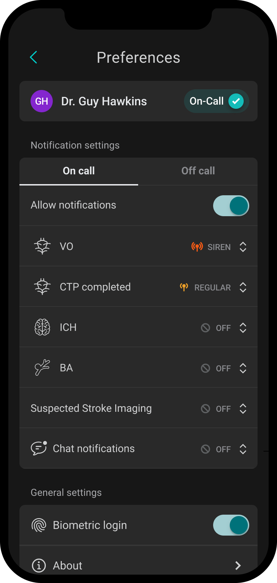
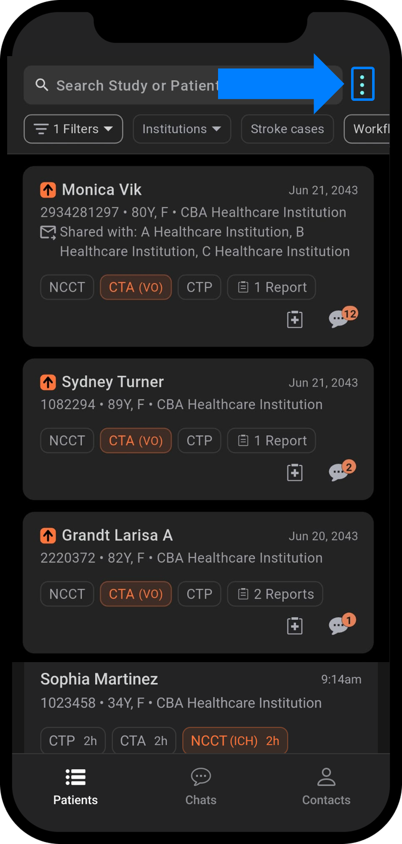
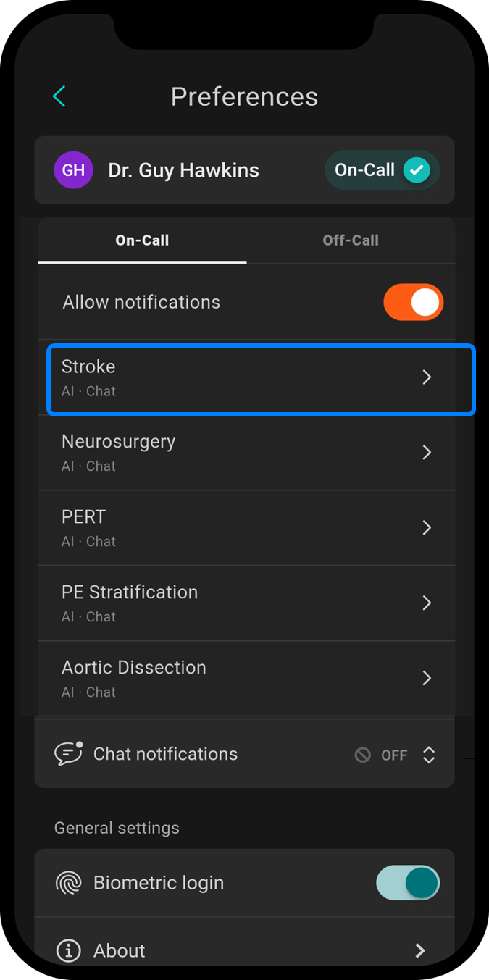
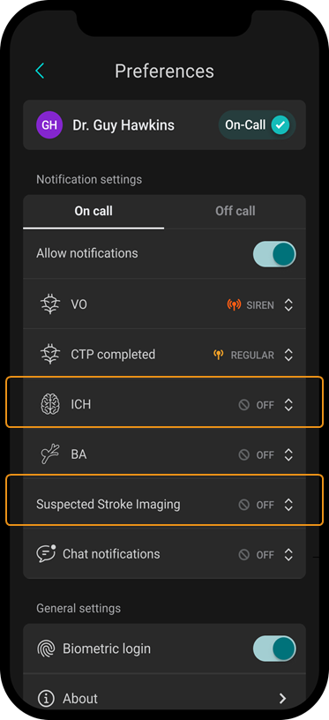
[Approved] UG0002 Rev 1.0 2025-05
Stroke Mobile Solution Enhancements Package
©Aidoc 2025
User Guide: New Imaging Notifications
New Stroke Mobile Notifications
The Mobile Stroke App offers three new notifications that allow clinical teams to focus on relevant cases, and supports clinicians in managing emergent situations effectively.
Notification | Description | Default
First Suspected Stroke Imaging | First stroke-related imaging series added to Patient Card | On/Regular
ICH | Head NCCT with suspected ICH AI flag available in the app. | Off
BA | Head CTA with suspected BA AI flag available in the app. | Off
VO | Head CTA with suspected VO AI flag available in the app. | On/Siren
CTP | CTP imaging is available in the app. | On/Regular
NEW
NEW
NEW
Editing User Notification Settings
You can change the default setting (ON/OFF) and sound (Regular/Siren) of the mobile stroke notifications via the Preferences menu:
1. Click on the Home Screen Preferences menu
2. Click on Stroke Flow Notifications dialog
3. Modify notification settings/sound as needed.
14

Slide 11
www.aidoc.com
[Approved] UG0002 Rev 1.0 2025-05
Stroke Mobile Solution Enhancements Package
©Aidoc 2025

